Slide 1
Welcome to Donington Cowley Endowed Primary School
Parents Meeting: June 2023
Notes:
SThank you so much for coming.

Slide 2
Statutory Framework for the Early Years Foundation Stage, Department for Education 2021
“Every child deserves the best possible start in life and the support that enables them to fulfil their potential. Children develop quickly in the early years and a child’s experiences between birth and age five have a major impact on their future life chances. A secure, safe and happy childhood is important in its own right.”
Notes:
Recent research evidence demonstrates that...
Consistency across home and school promotes achievements for young children
Family involvement in children’s learning has an influence on children’s happiness, achievement and learning
Parent/school partnership can improve children’s motivation, behaviour and self-esteem and language development

Slide 3

Our School Values
Notes:
- great opportunity for the children- smaller classes (at least to begin with!) more space/ adults to support learning
The classes will work very much together so the children receive the same experiences/ learning opportunities.

Slide 4
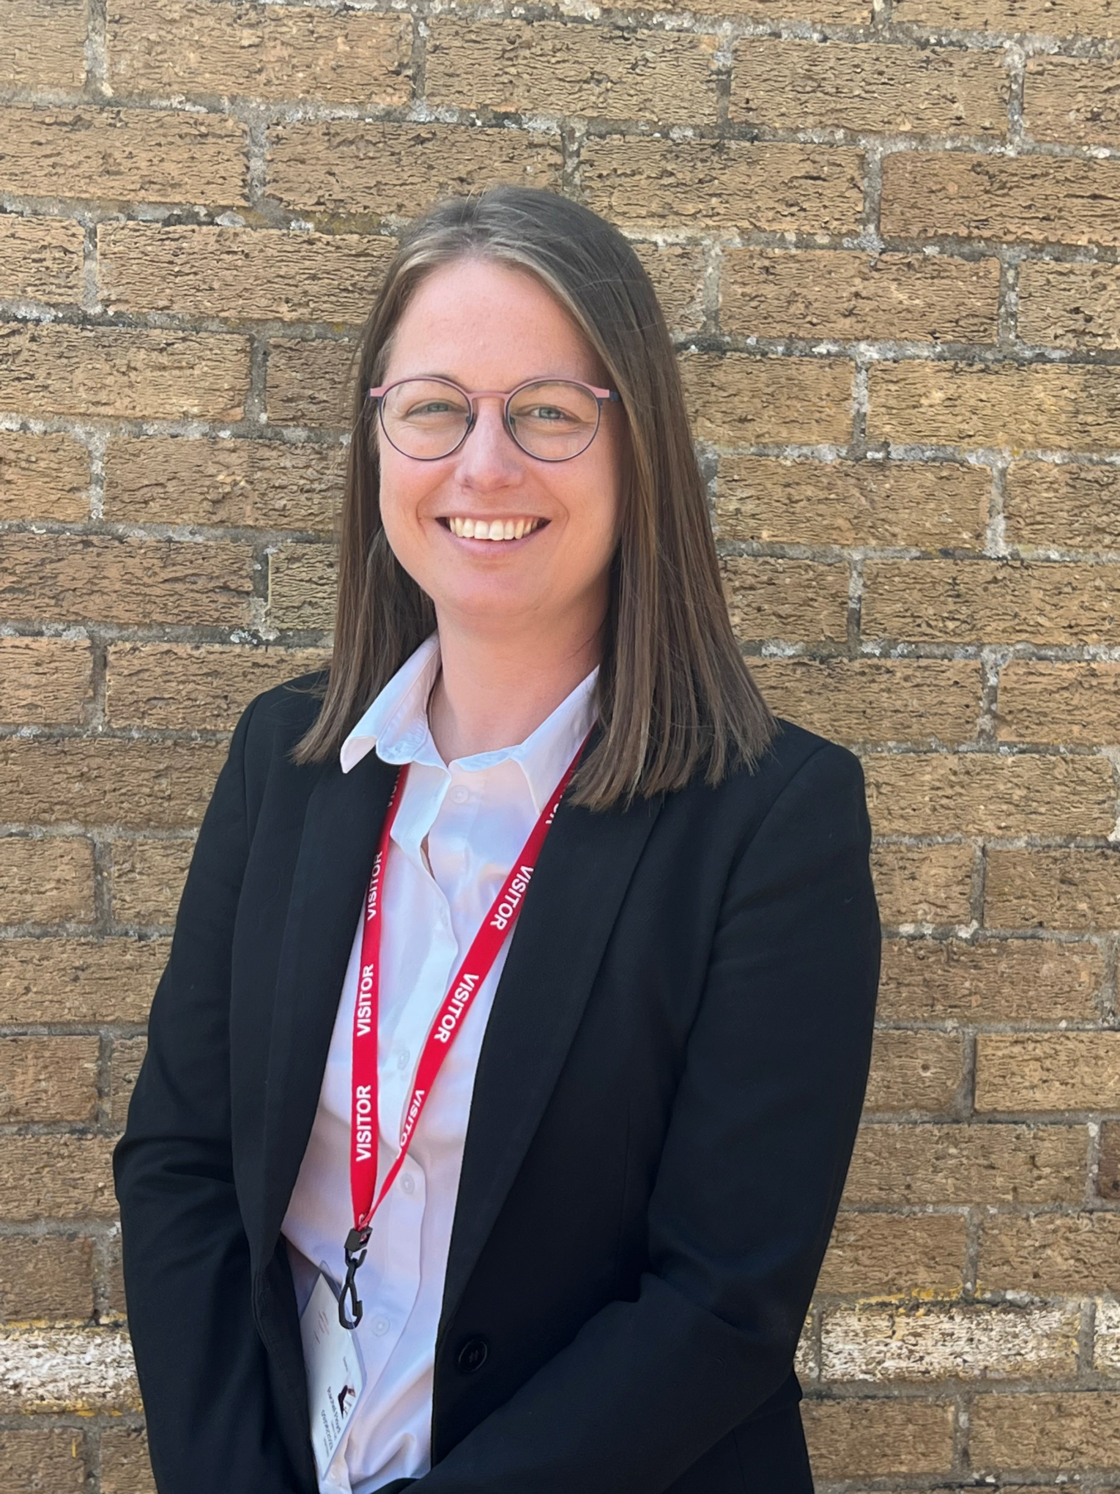
Senior Leadership Team
Mrs Foston
Headteacher
Mrs Floyd
Chair of Governors
Notes:
2 classes- great opportunity for the children- smaller classes (at least to begin with!) more space/ adults to support learning
The classes will work very much together so the children receive the same experiences/ learning opportunities.

Slide 5
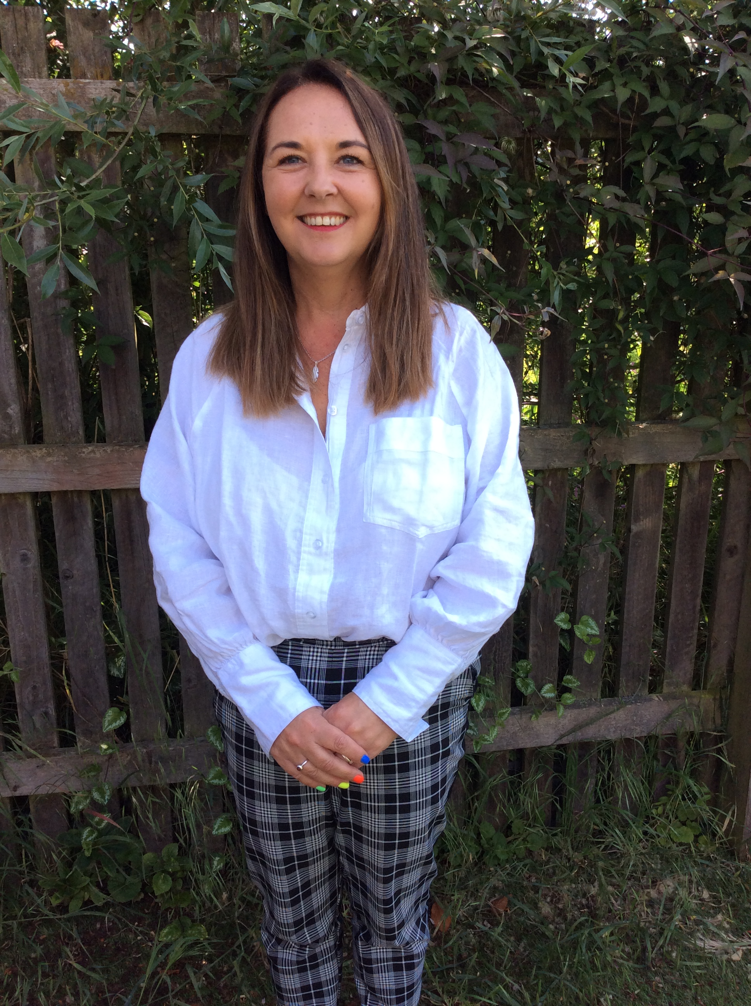
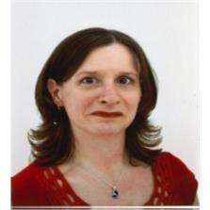
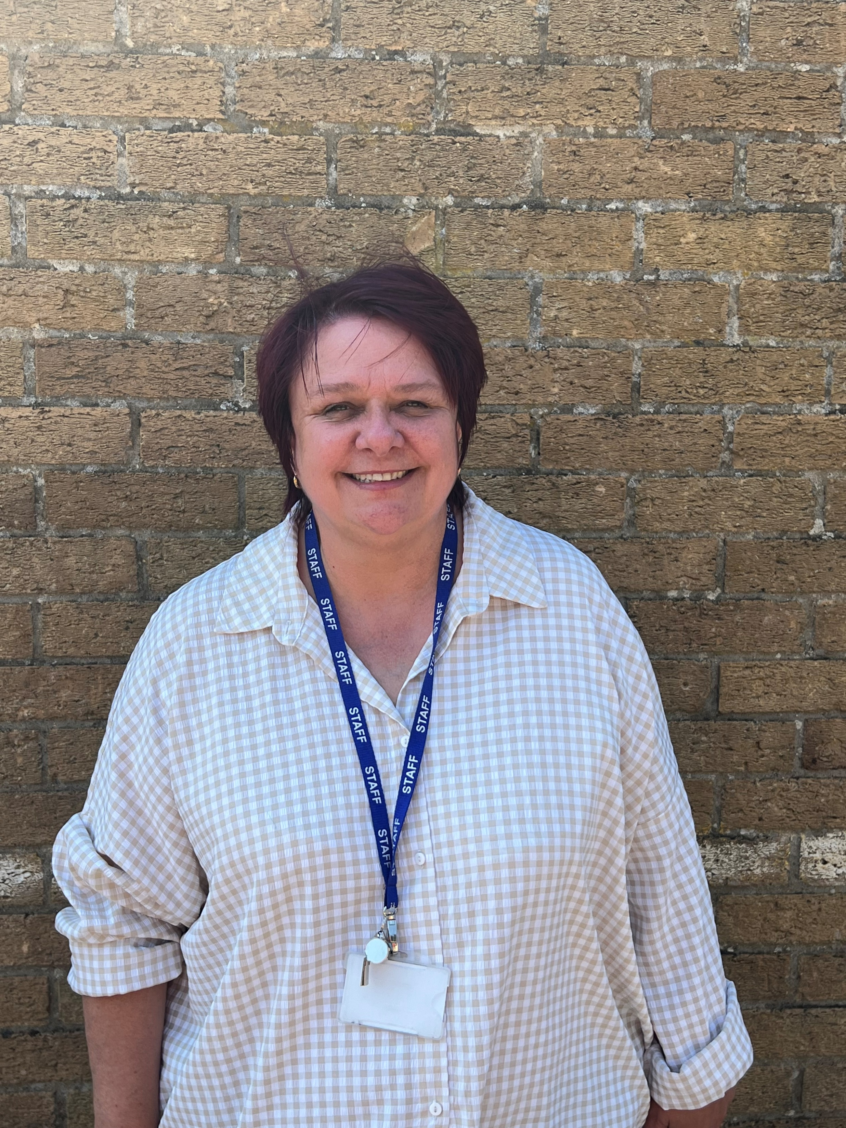
Senior Leadership Team
Mrs Ogden
Assistant Headteacher and
SENDCo
Mrs Williams
Assistant Headteacher
Mrs Millard
Inclusion Lead

Slide 6

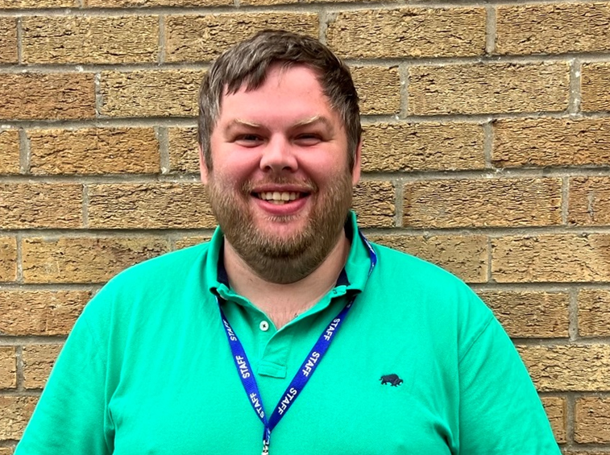
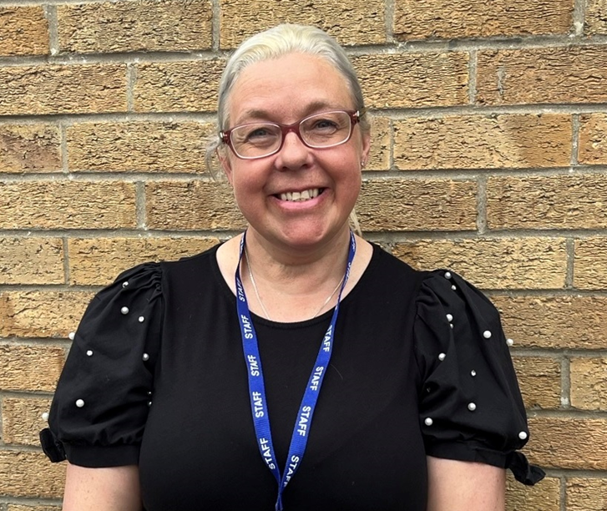
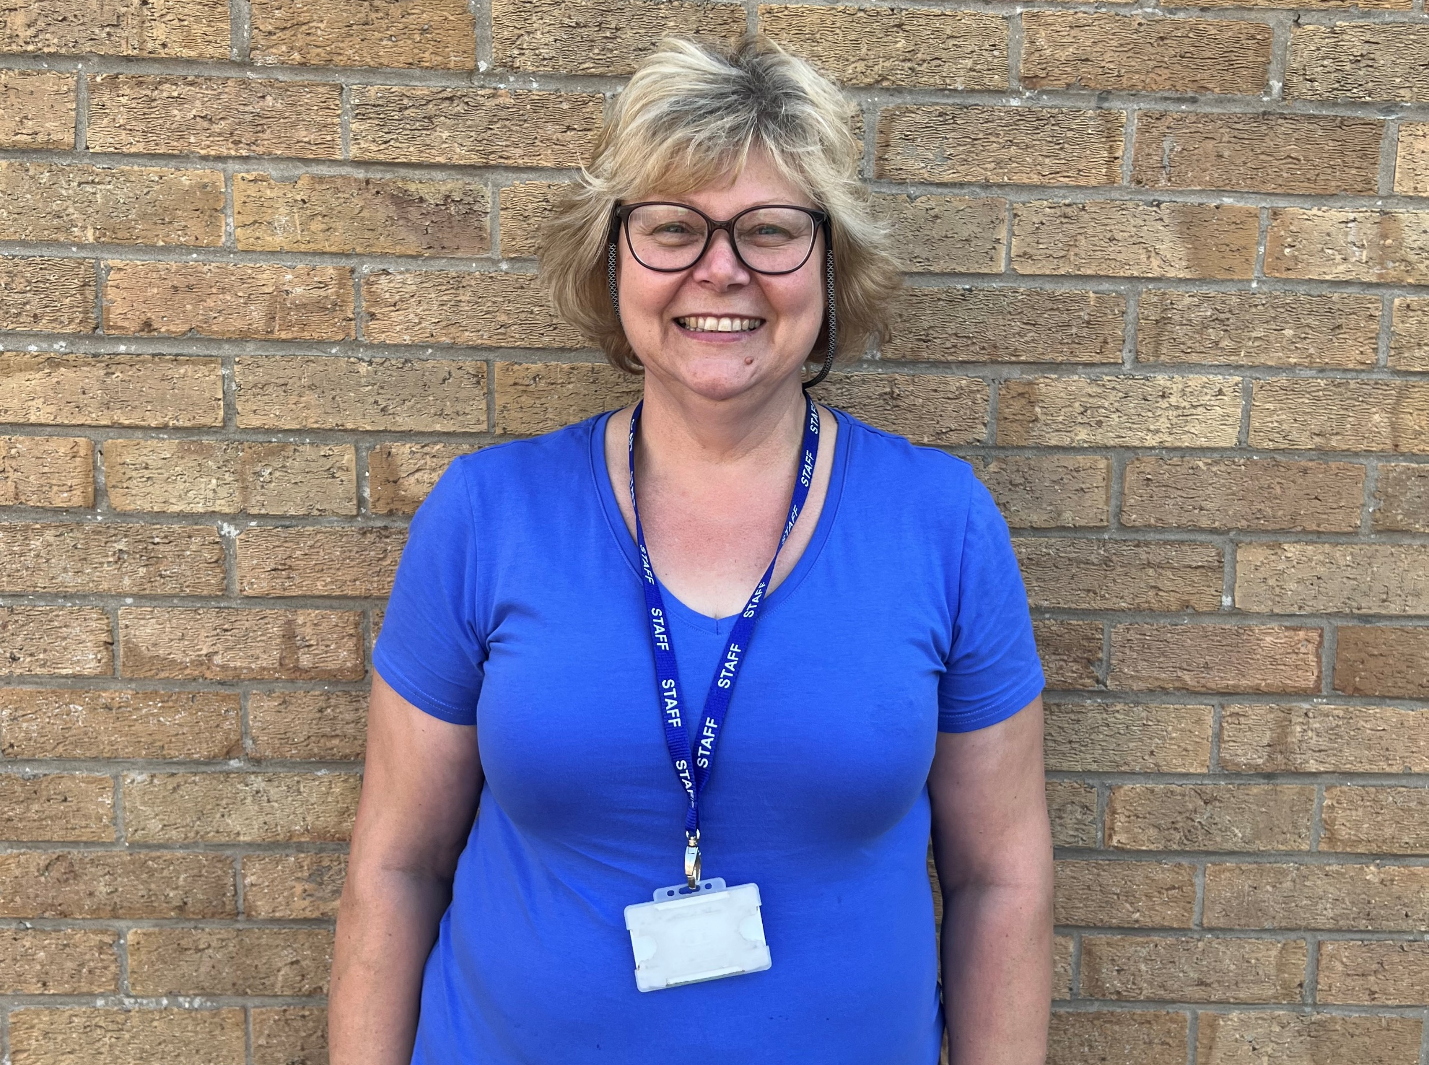
EYFS Team
Mr Smith
Ladybirds Class Teacher
Mrs Williams
Teaching Assistant
Mrs Glass
Teaching Assistant
Notes:
2 classes- great opportunity for the children- smaller classes (at least to begin with!) more space/ adults to support learning
The classes will work very much together so the children receive the same experiences/ learning opportunities.

Slide 7

Ladybirds Class
We have planned a very exciting new curriculum.
Our topics are:
Autumn 1 | Marvellous Me
Autumn 2 | Pole to Pole
Spring 1 | Ticket to Ride
Spring 2 | Come Outside
Summer 1 | Terrific Tales
Summer 2 | Amazing Animals

Slide 8
What is the Early Years Foundation Stage?
The Early Years Foundation Stage (EYFS) is the stage of education for children from birth to the end of the Reception year.
It is based on the recognition that children learn best through play and active learning.
Notes:
Learning through play is encouraged both indoors and outdoors. Self-chosen activities lead to high quality learning opportunities and personal development. Alongside this, adult-led teaching and learning develops early reading, writing and maths skills and knowledge to build solid foundations for future learning and prepare them for the next step in their education. At Donington Cowley Endowed Primary School, we recognise every child as a unique individual who can flourish and learn at their own pace and in their own individual way.

Slide 9
In the EYFS there are specific areas that we must cover in our curriculum.
The Prime Areas
Communication and Language
Physical Development
Personal, Social and Emotional Development
The Specific Areas
Literacy
Mathematics
Understanding the World
Expressive Arts and Design
Notes:
Prime areas are a focus during first half of autumn term to enable the children to achieve in the specific areas.
If you can’t talk about it- you can’t write about it
If you can’t do large movements/ have good fine motor control you can’t hold a pencil
If you are worried/ anxious/ falling out with friends- not happy and secure to learn other things

Slide 10
There are three characteristics of effective learning that are taken into account when we plan and guide children’s activities.
Playing and exploring
Active learning
3. Creating and thinking critically
Notes:
The characteristics of effective learning describe behaviours children use in order to learn. To learn well children must approach opportunities with curiosity, energy and enthusiasm. Do they come up with their own ideas/ make links in their learning/ challenge themselves/ persevere/ make predictions and test them out etc.

Slide 11
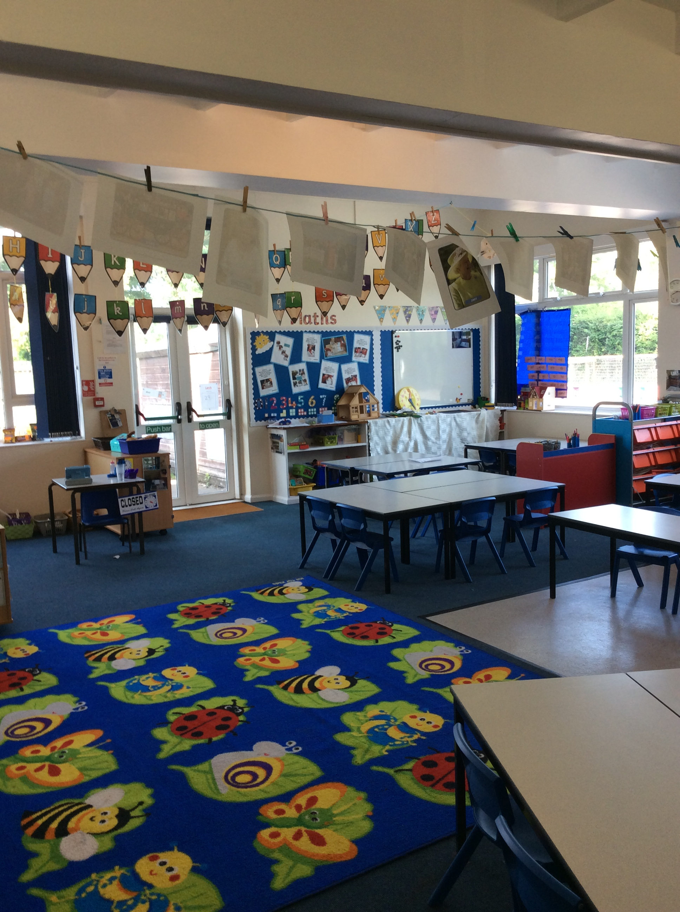
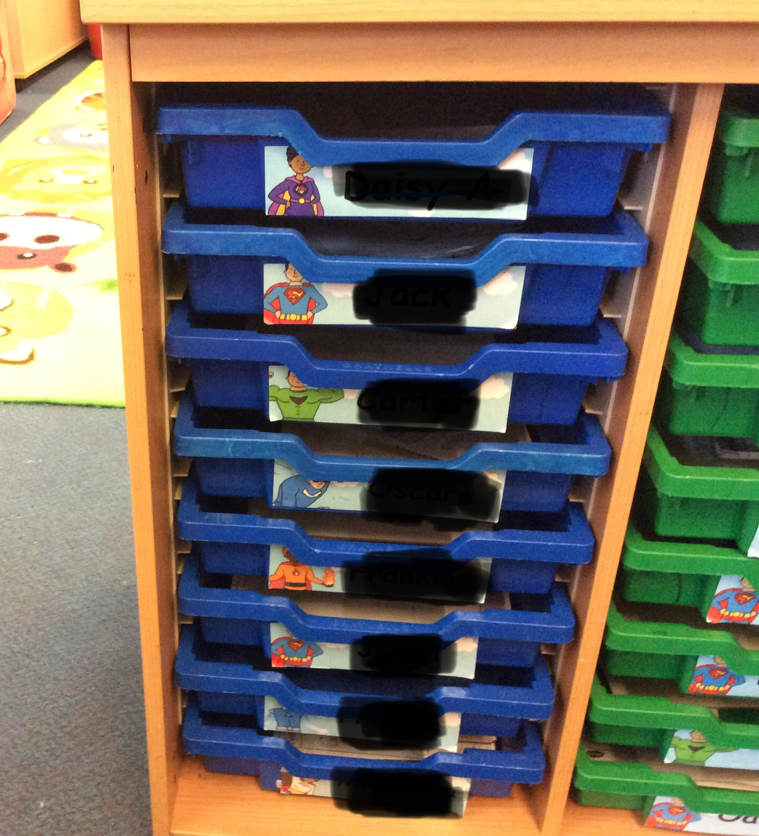
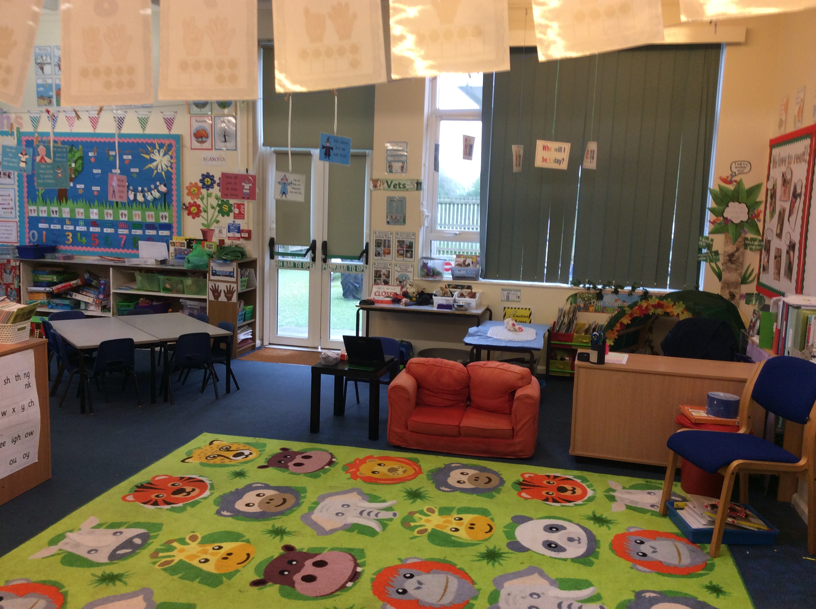
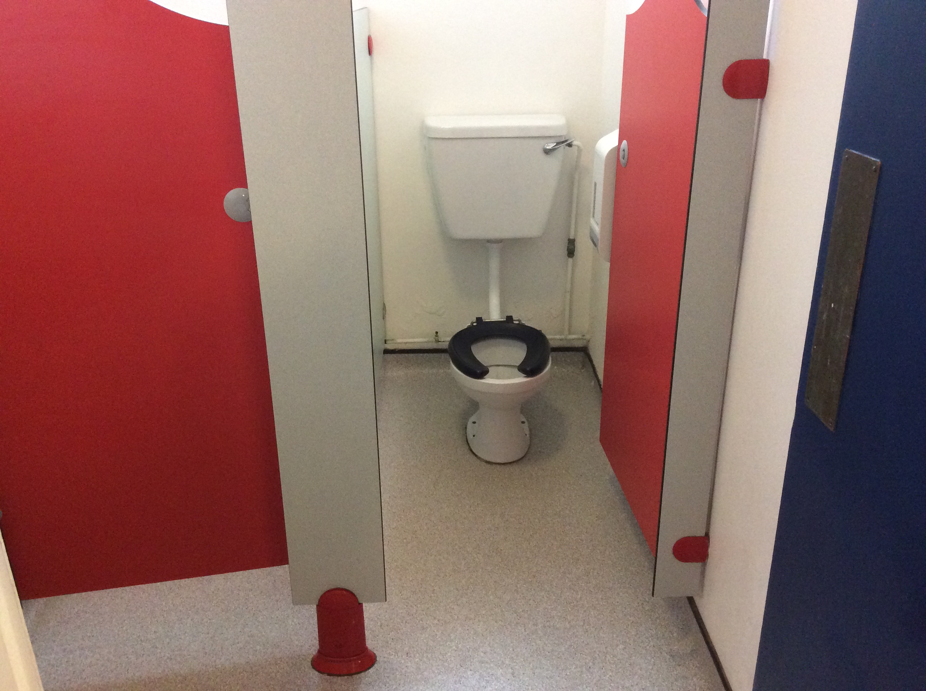
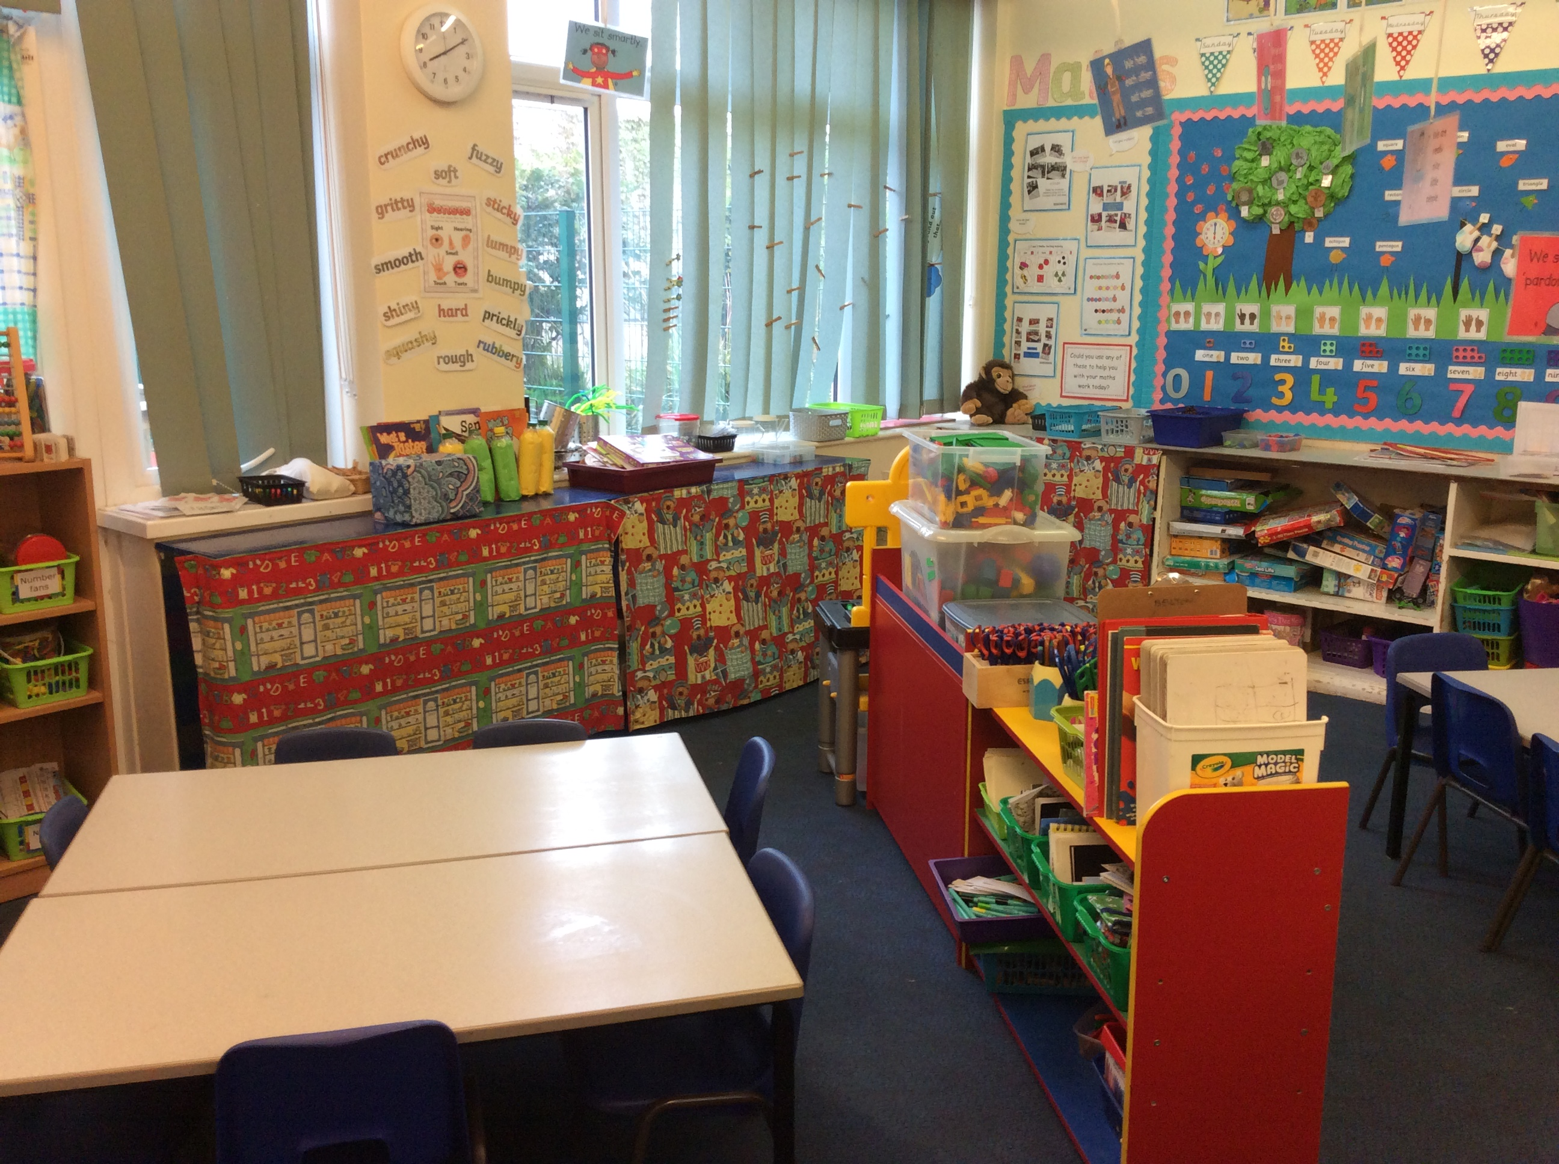
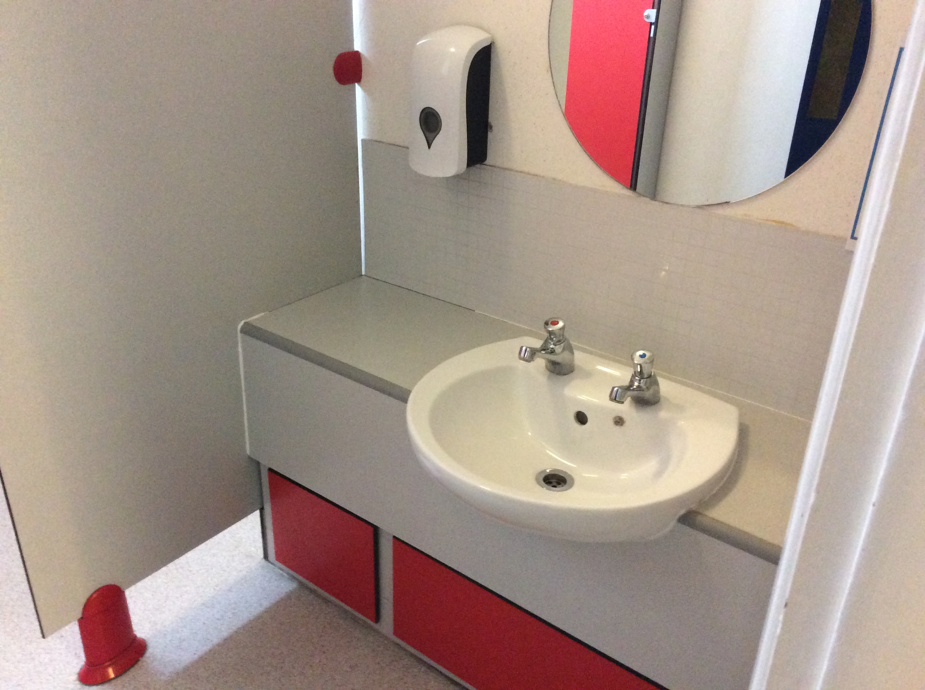
Our Classrooms
Notes:
Thank you so much for coming.

Slide 12
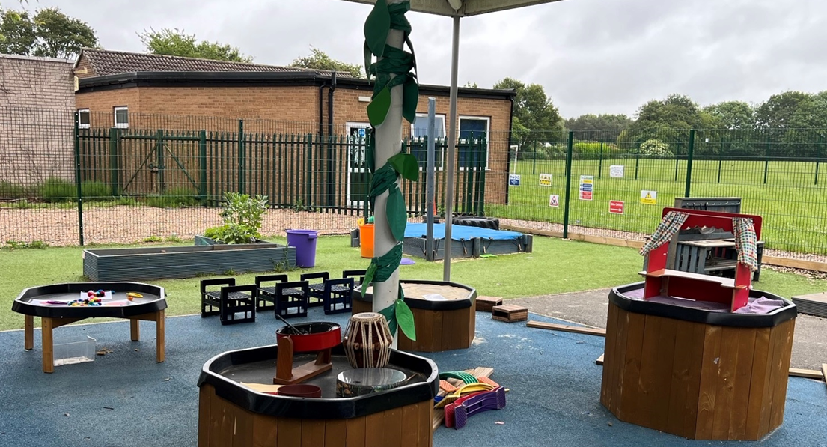
Our Outdoor Area
Notes:
Thank you so much for coming.

Slide 13






A typical morning in Reception…
8.45am Come in, hang coat up, fine motor skills, such as dough disco
9am Register
9.10am RWI then continuous provision inside and outside
10.15am Playtime with fruit provided
10.30am Milk time
10.50 Maths/ Own Learning and adult focused tasks (inside and outside)
11.45am Get ready for lunch/ story
12.10am Lunch
Notes:
The children’s day is balanced between adult focused activities and independent learning time where the children have the choice what they do. They are encouraged to become independent learners- eg find their resources and put them away at the end.
We use both inside and outside daily.

Slide 14

A typical afternoon in Reception…
1.10pm Register
1.30pm Topic /R.E/Music/PSHE –
        adults guided activity and independent learning (inside and outside)
2.45pm Assembly/story time
3.05pm Get ready for home time
Reception Learning is not always clean! Please be understanding!
Notes:
We also have a P.E. No 2 days are the same! Although we have aprons and will insist they are worn, children have an amazing ability to get stuff on their clothes! It should be washable such as chalk etc

Slide 15
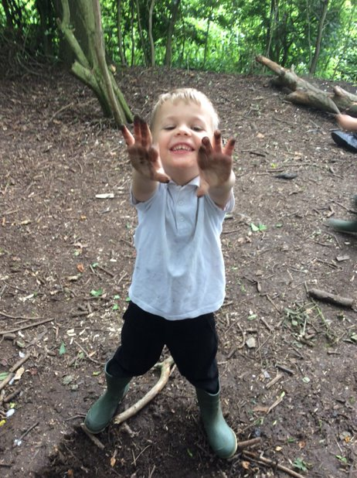
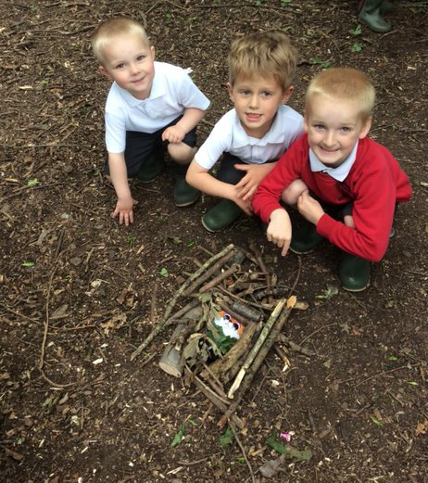
Forest School
The children will get the chance to enjoy a Forest School session in our school grounds.
Notes:
Forest school is a great activity which includes team games, team working skills, an increase in their self belief, confidence, learning capacity, enthusiasm, communication and problem-solving skills and emotional well-being. Provides opportunity to take risks in a controlled environment. Also great fun!

Slide 16

Read Write Inc
We introduced Read Write Inc at Easter and are seeing
some amazing results.
Parent video: What is Read Write Inc Phonics - YouTube

Slide 17

The first few weeks
We will be carrying out assessments to find out what the children already know and can do and will then use this information to help us develop an individual learning programme for each child.
We will be using ‘Tapestry’ to record ‘Wow!’ moments and you will be able to access these from your mobile or a laptop once you have been signed up. We want to spend as much time as possible interacting with the children rather than taking photos all the time.
Notes:
S

Slide 18

The first few weeks
All the children will start full time from Wednesday 6th September
On a P.E day the children come to school in their P.E kit and stay in it all day
There is the option to bring their own packed lunch or have a free school dinner. The school dinners are provided by Willoughby Foods and they are lovely. We often find that children will try things that they haven’t tried before. If your child has a packed lunch from home please don’t pack too much
Free fruit is provided at playtime and milk after playtime
https://www.willoughby-foods.co.uk/

Slide 19
Attendance
Please ensure your child is in school on time. School opens at 8:45am and registration is at 9:00am
It is important your child is in school every day
If your child has any appointments, please inform us

Slide 20


Medical Matters
Any sickness or diarrhoea, must be followed by 48 hours absence
Any absence requires a note, a telephone call or a message via ParentMail explaining why
Head lice are common! Please check regularly and treat as recommended
Any medicines can only be administered by prior arrangement

Slide 21
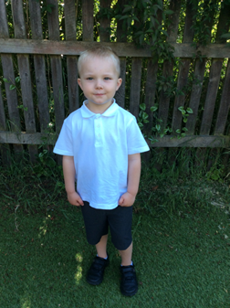
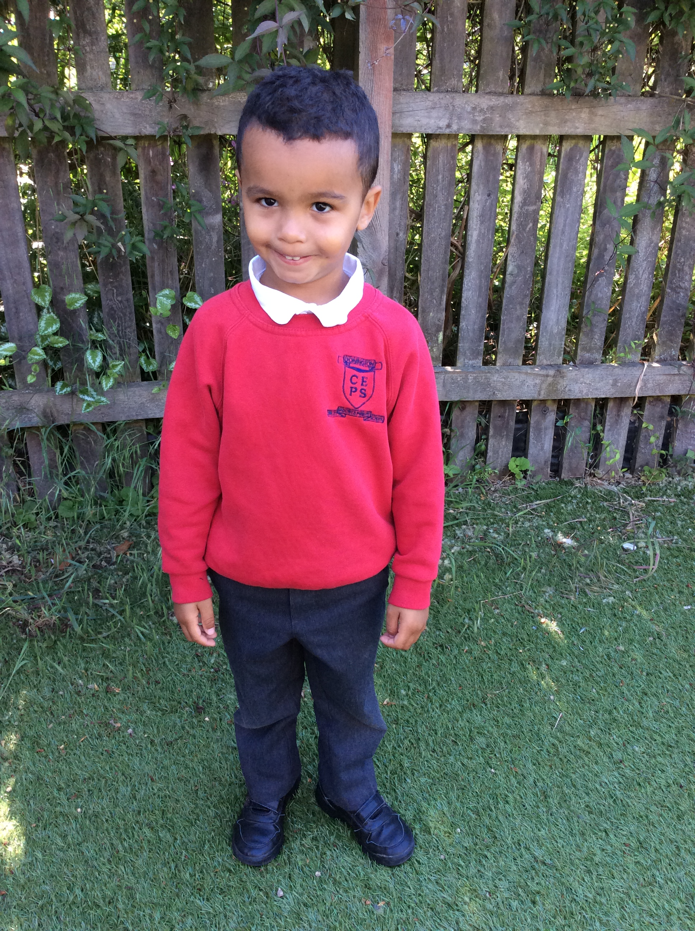
Uniform

Slide 22
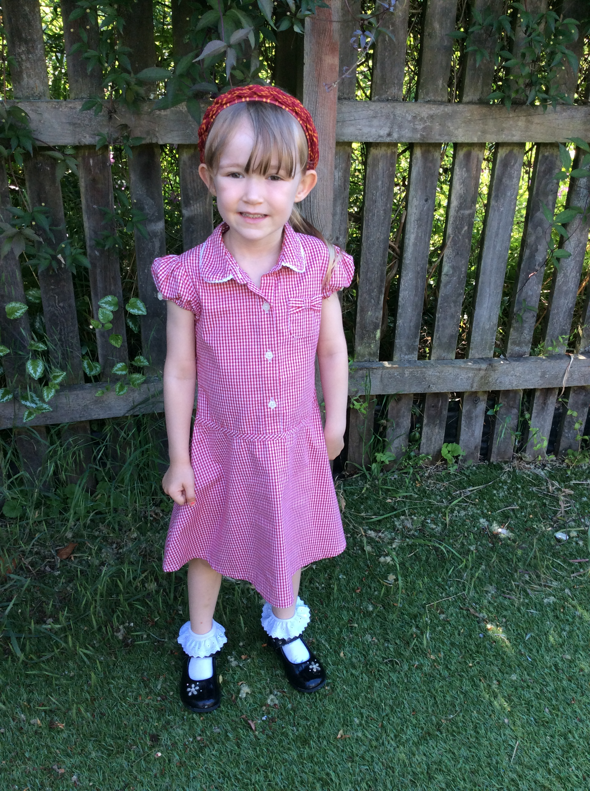
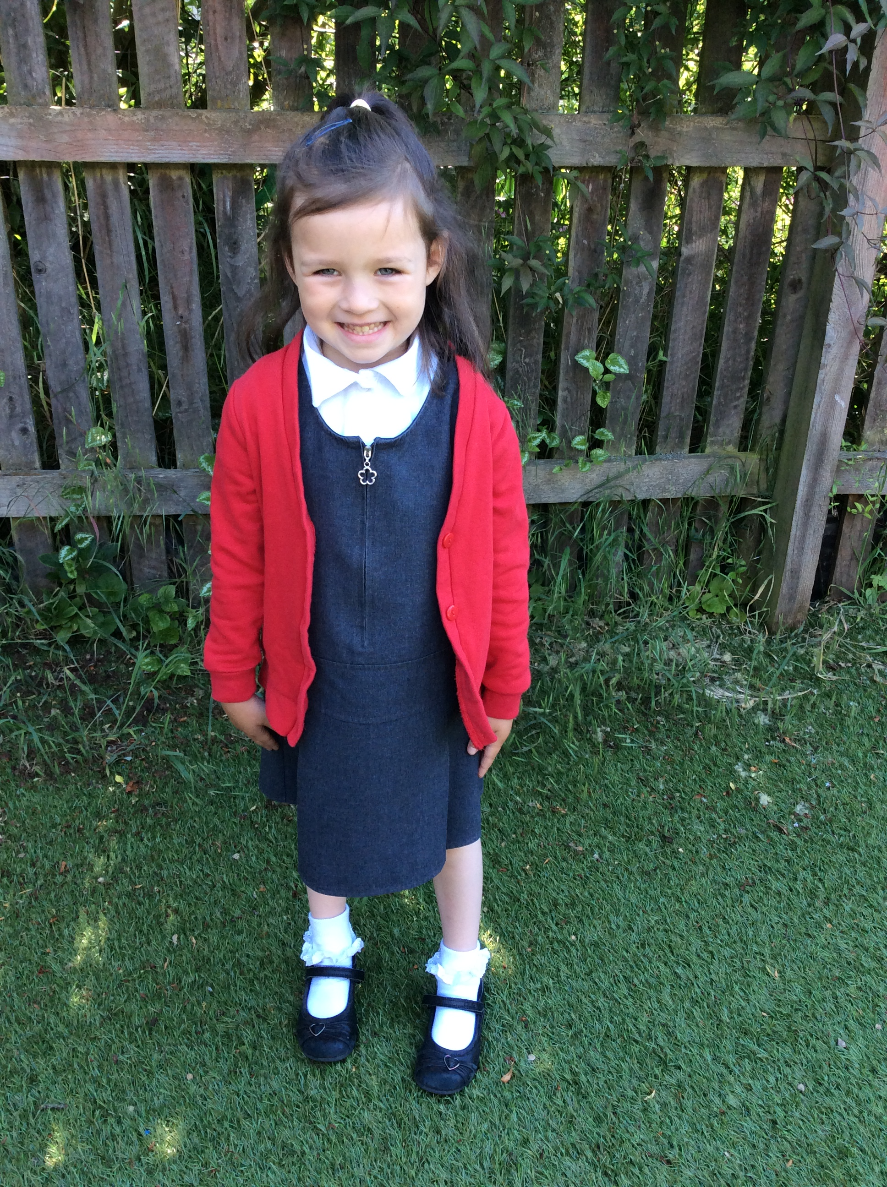

Slide 23
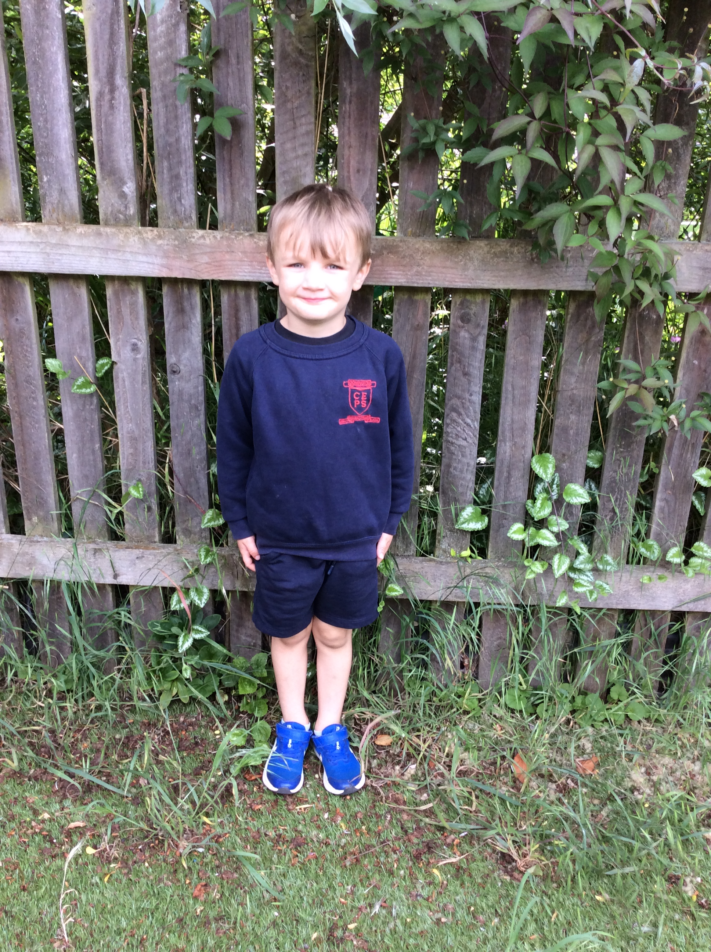
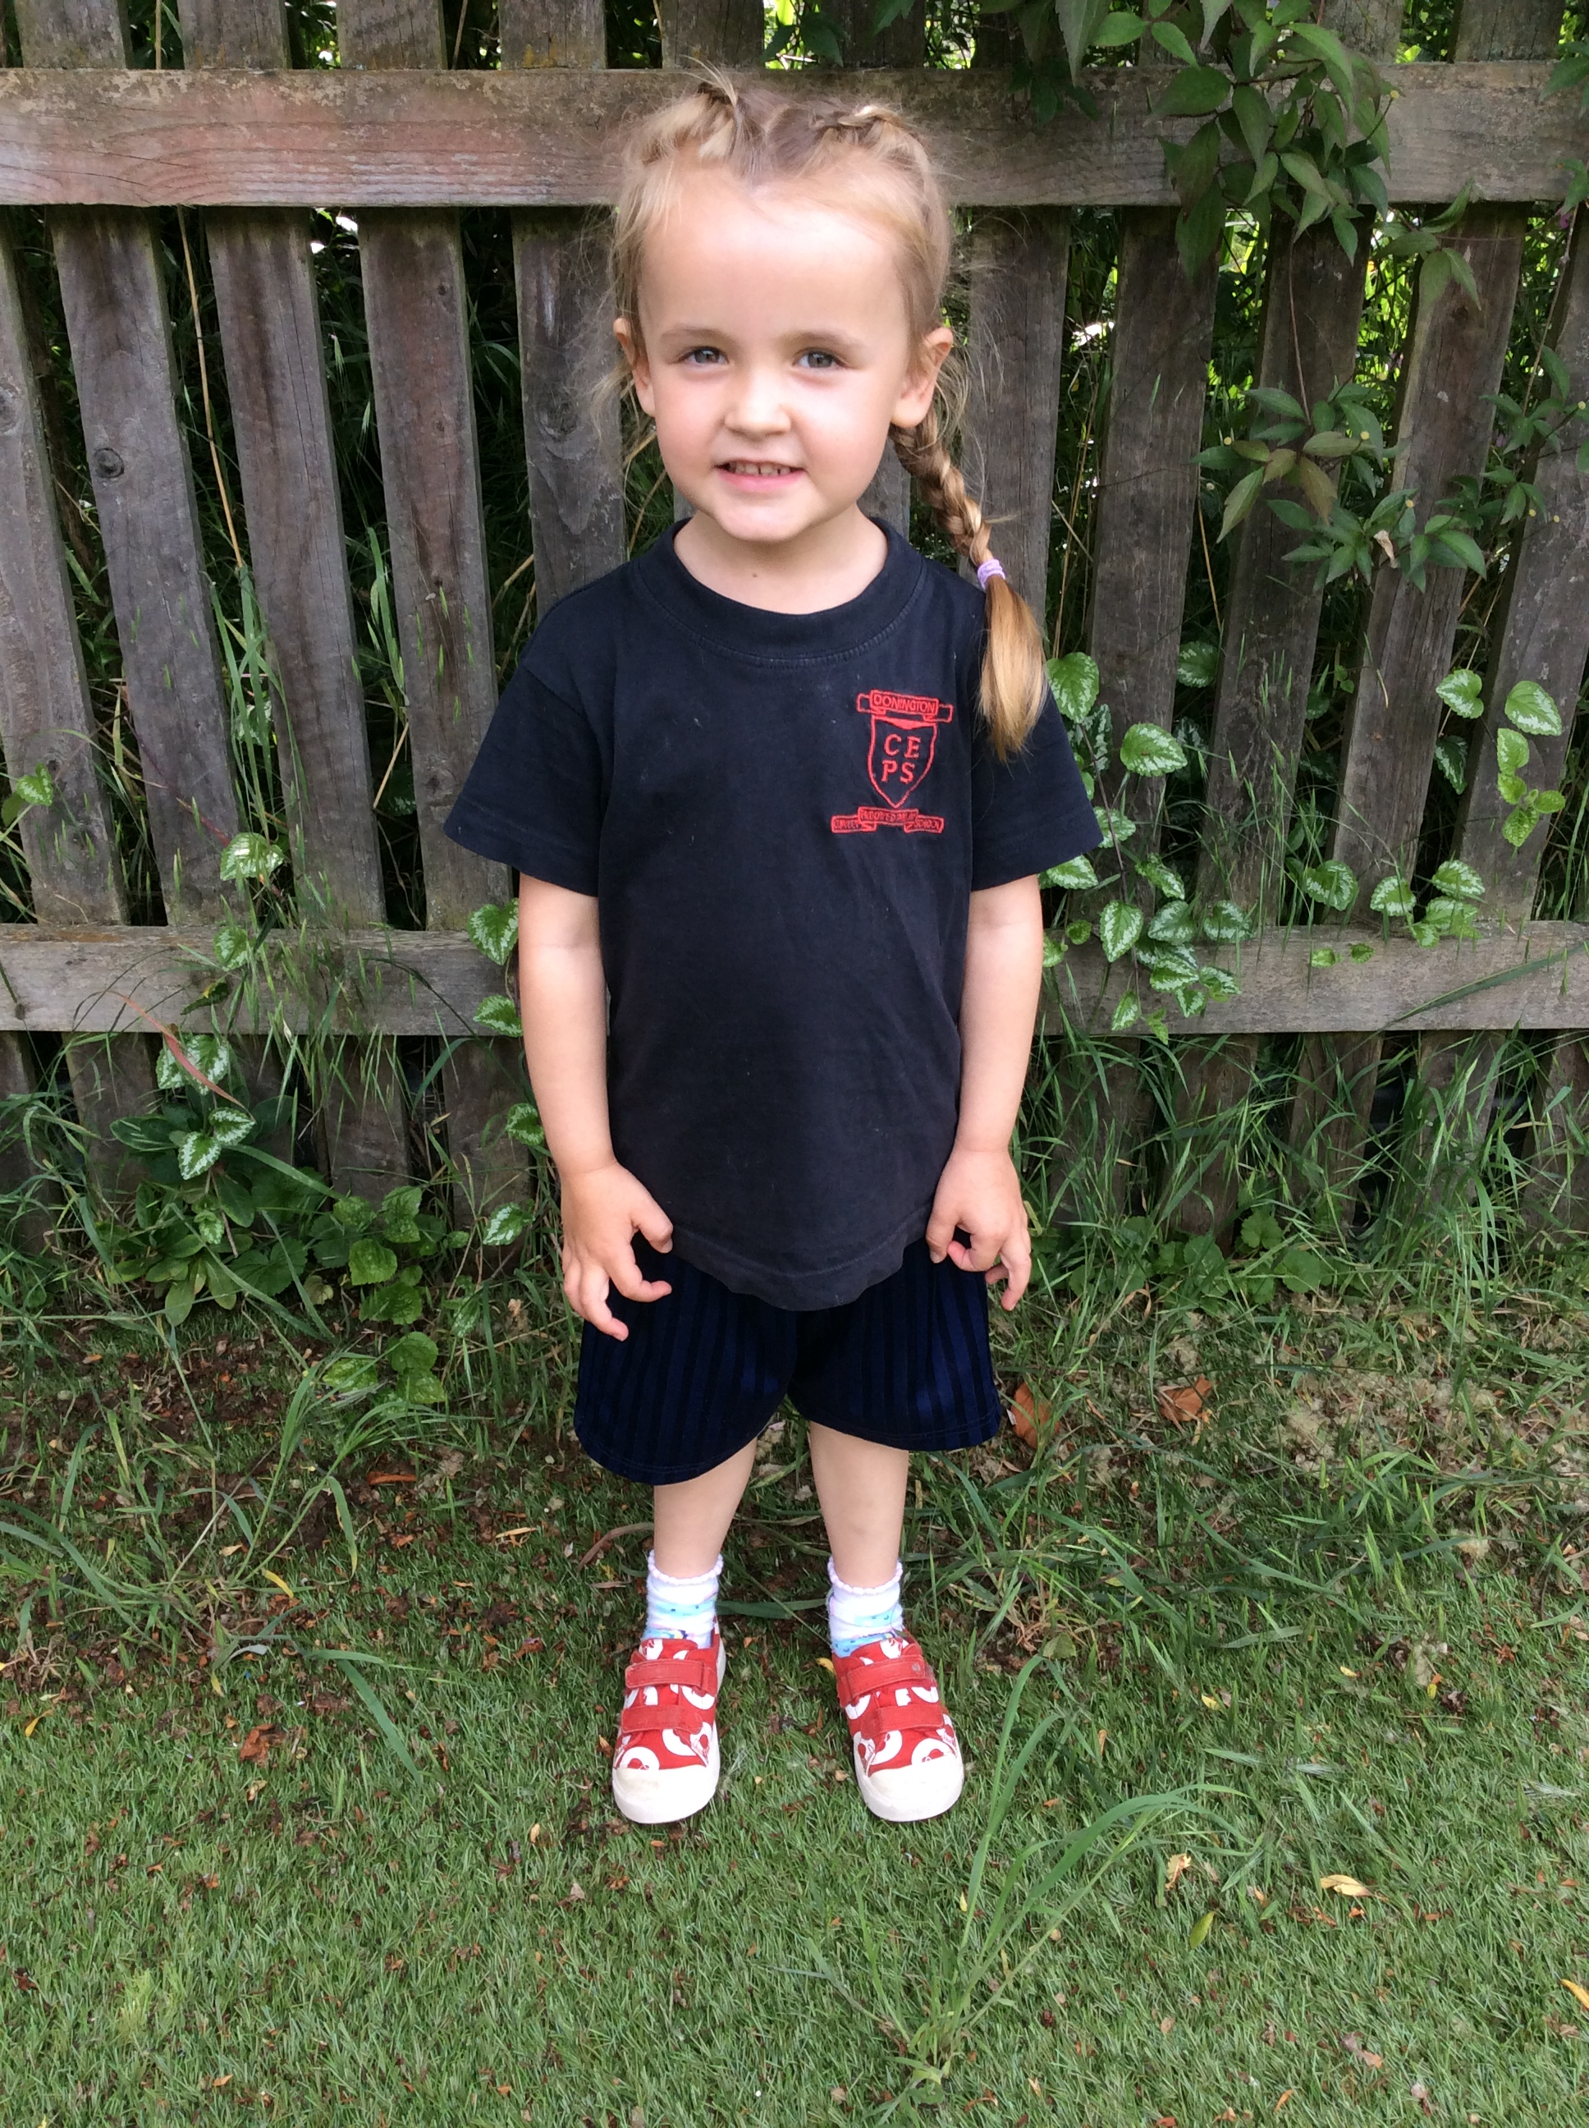
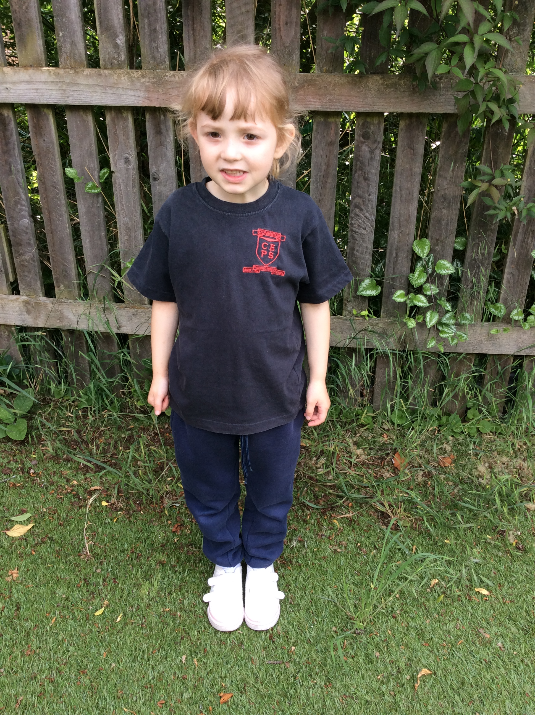
P.E Kit

Slide 24


Please ensure all clothing is named. Spare clothing is useful in September.
Uniform is available from https://www.nationwideschooluniforms.co.uk/school-uniform/primary-school/donington-cowley-endowed-primary-school.html
Please see our school website for more details.
Notes:
Uniform all looks the same when you’re 4!

Slide 25
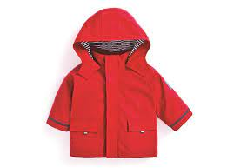


What does my child need at school?
Coat- good to bring one every day
as our weather is so changeable!
Forest school clothes- we will send
you a letter detailing this nearer the time
Book bag- please bring every day so letters, library and reading books
can be transported safely
Named water bottle
Wellington boots
(to be kept at school)

Slide 26
Dates for your diary
7th July transition morning 9.15-11.45am
Wednesday 6th September 1st Day of School

Slide 27
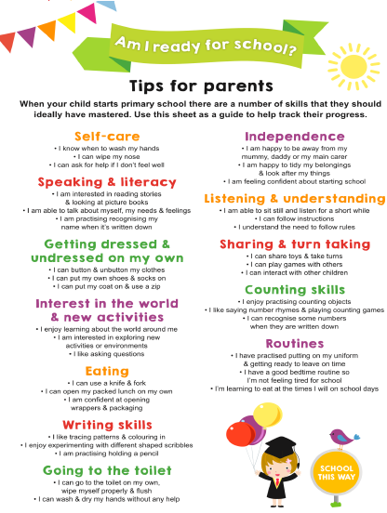

Slide 28

And Finally…
If you have any worries or concerns please do ask or email and we will do our best to help you ☺ Ladybirds@cowley.lincs.sch.uk
Thank you for coming. We are looking forward to seeing you all in September

